Slide 1
Analytics in Business
Final Project: People Picking
Group 10 | Joaquín Coitiño, Hazel Ho, Andrea Iglesias,
Jason Kuilan, Lukas Wolff, Dian Yue Josef Zhu

Slide 2
Index
Task
Leaders
Analysis
Choice

Slide 3



Task
Constraints
Five people for each task
Each person picked only once
No more than 30 collective friendship in-degree for each task.
Creativity
(Design)
^{Implementation (Execution)}
^{Influence} ^{(Lobbying)}
Icons made by FreePik from www.flaticon.com

Slide 4
Leaders - Measures
PageRank
Measure a person’s competencies
Cosine Similarity
Measure flexibility in choosing group members
Found significantly negative correlation between average of Cosine Similarity and average of PageRank of successors (out-degrees).
Friendship In-degree & Party Choice

Slide 5
Leaders – Option 1
 | ID | Creativity PageRank | Implementation PageRank | Influence PageRank | Friendship In-degree | Cosine Similarity
Creativity | 7 | 0.06751 | 0.04287 | 0.05155 | 8 | 0.16667
Implementation | 19 | 0.04974 | 0.04539 | 0.05545 | 10 | 0.5156
Influence | 21 | 0.05034 | 0.05533 | 0.07737 | 10 | 0.45505

Slide 6
Leaders – Option 2
 | ID | Creativity PageRank | Implementation PageRank | Influence PageRank | Friendship In-degree | Cosine Similarity
Creativity | 21 | 0.05034 | 0.05533 | 0.07737 | 10 | 0.45505
Implementation | 33 | 0.05356 | 0.07835 | 0.02504 | 15 | 0.05556
Influence | 19 | 0.04974 | 0.04539 | 0.05545 | 10 | 0.5156

Slide 7
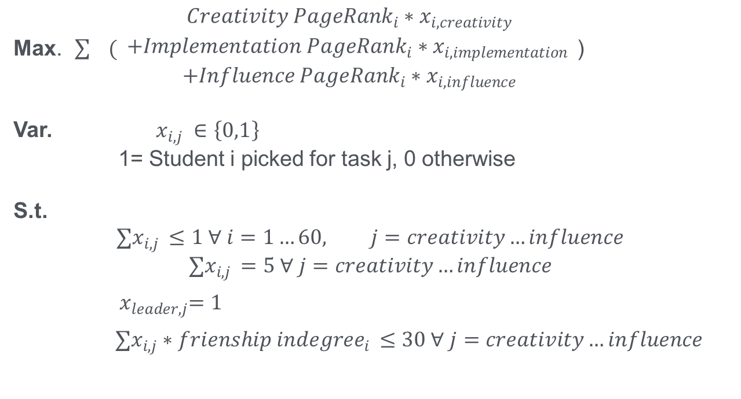
Analysis
Optimisation model
Max. $\sum{ ( \begin{aligned}{Creativity PageRank}_{i}∗x_{i,creativity} \\ +{Implementation PageRank}_{i}∗x_{i,implementation } \\ +{Influence PageRank}_{i}∗x_{i,influence}\end{aligned}}$ )
Var. $x_{i,j} ∈\left\{0,1\right\}$
1= Student i picked for task j, 0 otherwise
S.t.
$$∑x_{i,j }≤1 ∀ i=1…60, j=creativity…influence$$
$$∑x_{i,j }=5 ∀ j=creativity…influence$$
${ x}_{leader,j}=1$
$$∑x_{i,j}∗{frienship indegree}_{i }≤30 ∀ j=creativity…influence$$

Slide 8
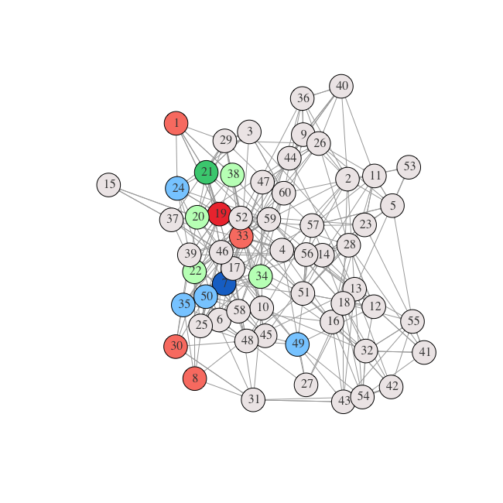
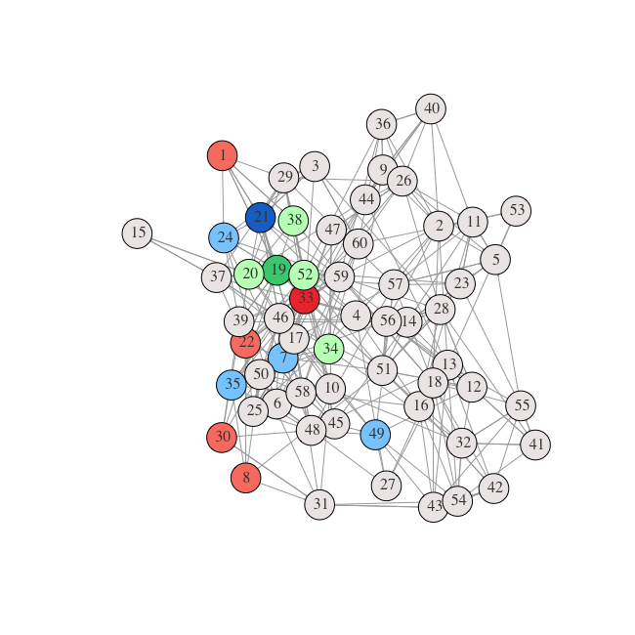
Analysis
Option 1
Option 2

Slide 9
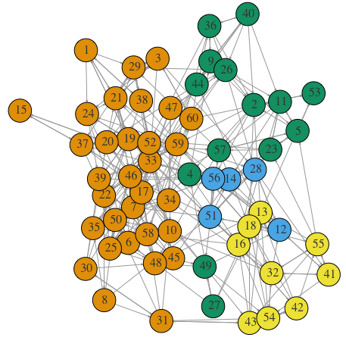
Analysis
Community detection (Infomap)
All nodes except one can be found in the orange cluster
Are other clusters being underrepresented by these choices for creativity and influence tasks?

Slide 10
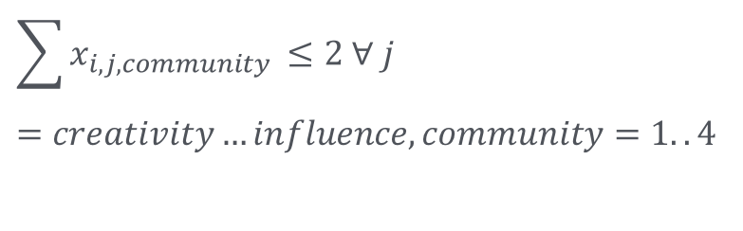
Analysis
Revisiting the model
A constraint was added to prevent the presence of more than 2 members of a cluster in these groups:
$$\sum{x_{i,j,community }}≤2 ∀ j=creativity…influence, community=1..4$$
To what extent will these new choices limit the task-specific PageRank
(cumulative ability) of the team members?

Slide 11
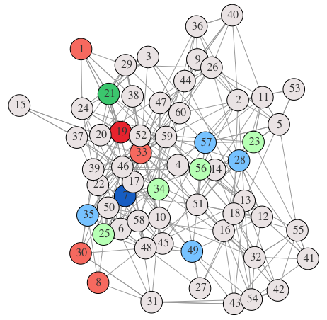
Analysis
Option 3
PageRank reductions
Influence: -0.0153554
Creativity: -0.0270657
-16.6%
-37.3%

Slide 12
Choice
vs.
Perceived Ability
Representativeness
Creativity
Influence
Combined
model

Slide 13
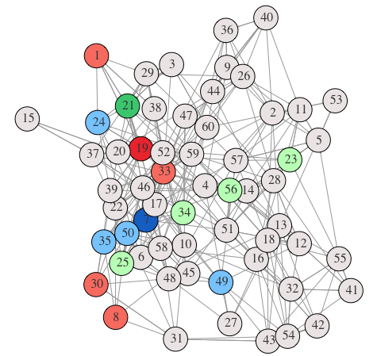
Choice
Creativity
7, 24, 35, 49, 50
Influence
21, 23, 25, 34, 56
Implementation
19, 1, 8, 30, 33

